Slide 1

Kerberos: A Vouch Protocol
Group presentation
Submitted to : Dr. Bo Sun
Date: 09/29/2015
Presented by:
Ashutosh Khandelwal - L20399765 Maulik Sharma - L20388616 Bhumit Patel - L20382154 Naman Turakhia - L20377965

Slide 2

Overview
Introduction
History
Motivation
Kerberos Functioning
Authentication Server (AS)
Ticket Granting Server (TGS)
Message Exchange
K4 vs K5
Drawbacks
Proposed Implementation
Conclusion
References

Slide 3
Introduction
A set of protocols and mechanisms have been created to deal with information security issues.
A Network Authentication Protocol.
Uses private-key cryptography for strong authentication.
Cryptography refers to the techniques which allows confidentiality, data integrity, access control and authentication.
Authentication can be build resulting in the required security to the computer network system.
Main aspect of using cryptography is to prevent or detect spasms.

Slide 4
Motivation
Now a days, the computer network architecture uses clients and distributed or centralized servers.
As the network connection to other machine are supported, we require client systems to authenticate themselves to servers.
Traditional methods are not suitable in computer networks where attackers can monitor network traffic and intercept passwords.

Slide 5
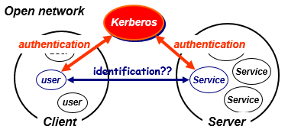
Cont.…
Thus, Kerberos is a trusted third party : uses a vouch protocol between clients and servers.

Slide 6
History
Kerberos was designed and developed at MIT (Massachusetts Institute of Technology) by project Athena.
Several versions of protocol exists :
First three versions occurred internally in MIT
Version 4 being the first version to be released outside of MIT
Currently, Kerberos is up to Version 5.
Kerberos has been adopted by several private companies as well as added to several operating systems such as :
Sun Microsystems
Apple
Google
Microsoft & etc.

Slide 7
Kerberos Functioning
The Kerberos protocol is designed to provide reliable authentication over open and insecure networks where communications between client and server where it may be intercepted.
As there is long term private key between client and Kerberos, the protocol allows a client to be authenticated repeatedly on multiple servers.
It represents an authentication service based on the symmetric key encryption and on a Key Distribution Center (KDC) which is a trusted third part.
KDC consists of two parts : Authentication Server (AS) and Ticket Granting Server (TGS).

Slide 8
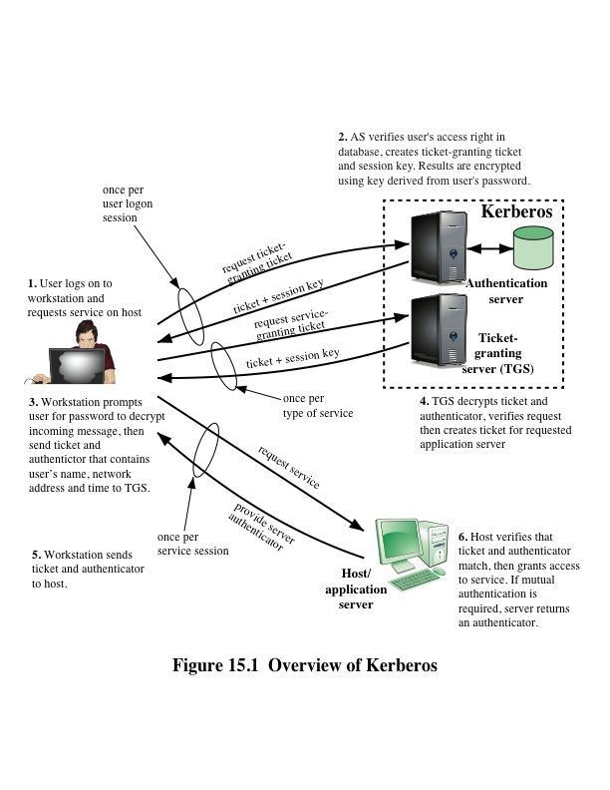
Cont.…

Slide 9
Authentication Server (AS)
The client sends a plaintext request to the AS asking for a ticket it can use to talk to the TGS.
Request:
Login name
TGS name
Since this request contains only well-known names, it does not need to be sealed.

Slide 10
Cont.…
The AS finds the keys corresponding to the login name and the TGS name.
The AS creates a ticket:
Login name
TGS name
Client network address
TGS session key
The AS seals the ticket with the TGS secret key.

Slide 11
Cont.…
The AS also creates a random session key for the client and the TGS to use.
The session key and the sealed ticket are sealed with the user (login name) secret key.
Sealed with TGS key
Ticket:
login name
TGS name
net address
TGS session key
TGS session key
Sealed with user key

Slide 12
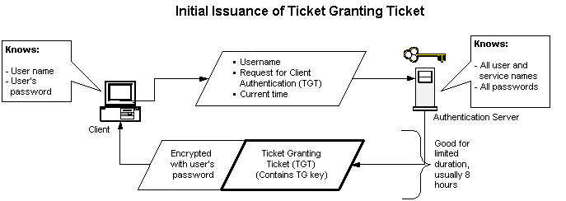
Ticket Granting Server (TGS)
The client decrypts the message using the user’s password as the secret key.
The client now has a session key and ticket that can be used to contact the TGS.
The client cannot see inside the ticket, since the client does not know the TGS secret key.

Slide 13
Cont.…
When a client wants to start using a server (service), the client must first obtain a ticket.
The client composes a request to send to the TGS:
sealed with
TGS key
TGS Ticket
Authenticator
sealed with
session key
Server Name

Slide 14
Cont.…
The TGS decrypts the ticket using it’s secret key. Inside is the TGS session key.
The TGS decrypts the authenticator using the session key.
The TGS check to make sure login names, client addresses and TGS server name are all ok.
TGS makes sure the authenticator is recent.
Once everything checks out - the TGS:
Builds a ticket for the client and requested server. The ticket is sealed with the server key.
Creates a session key
Seals the entire message with the TGS session key and sends it to the client.

Slide 15
Message Exchange
Kerberos message exchange authentication consists of following elements :
Realm: Set of managed nodes by KDC that stores on the same Kerberos database.
Options: Used to set certain flags for returning tickets.
Times: Used by clients to request following time settings in the tickets.
From – Starting time for requested ticket.
Till – Expiration time for the requested ticket.
Rtill – Only in tickets that have renewable flags which are set TRUE.
Nonce: Random value to be repeated in a message to assure response is fresh and has not been replayed by an opponent.
Subkey: It is an encryption key which is a client’s choice to protect application sessions.
Sequence Number: An optional field that specifies the starting sequence number to be used by the server for messages sent to the client during this session.

Slide 16
K4 vs K5
 | K4 | K5
Times | No time | From, till, renew_till
Encryption techniques | DES | Key with type & length
Double encryption | Found | Not found
DES mode | PCBC | CBC
Session key | One sub-session key per connection | One sub-session key per connection (negotiable)
Network address | IPv4 | Any
Ticket lifetime | Maximum 1280 min | Arbitrary

Slide 17
Kerberos Drawbacks
Like any security tool, it is also vulnerable to users making poor password choices.
Requires continuous availability of the central server. When the Kerberos server is down, no one can log on.
Kerberos requires the clocks of the involved hosts to be synchronized. The tickets have a time availability period and if the host clock is not synchronized with the Kerberos server clock, the authentication will fail with the Kerberos server clock.
In the meantime, all authentication is controlled by a centralized KDC, compromise of this authentication infrastructure will allow an attacker to impersonate any user.

Slide 18
Proposed Implementation
Kerberos framework can be improved further to integrate into ad-hoc network.
Algorithms can be changed according to the network needs in the future.
Framework should be more secure and scalable.
Kerberos will be seen to support mobile devices in future.
Looking forward to extend implementation to cover cross realm operation.

Slide 19
Conclusion
The Kerberos protocol provides authentication and strong cryptography to secure information system across an entire network or enterprise protocol is highly effective solution to network security problem.
The implementation of KDC database will increase the performance of protocol using principle of long term private key which is independent of the user password. So, we can overcome the problem of password guessing attacks.

Slide 20
References
Eman El-Emam , Magdy Koutb , Hamdy Kelash , and Osama S. Faragallah, “An Authentication Protocol Based on Kerberos 5”, International Journal of Network Security, Vol.12, No.3, PP.159170, May 2011
Kirti M.Shinde, Prof. R V. Shahabade, “ Security in WLAN using Kerberos”, International Journal of Scientific and Research Publications, Volume 4, Issue 6, ISSN 2250-3153, June 2014
Sanket Bhat, Saumitra Damle, Priyanka Chaudhari, Abhijeet Saraogi, “ KERBEROS: An Authentication Protocol”, International Journal of Advance Research in Computer Science and Management Studies, Volume 2, Issue 2, ISSN: 2321-7782, February 2014
https://en.wikipedia.org/wiki/Kerberos_(protocol)
http://web.mit.edu/kerberos/

Slide 21



